Slide 1
FHIR Starter: Architecture
Lloyd McKenzie
June 25, 2018
Notes:
Good morning. I’ve wanted to visit Russia since my grade 9 teacher tried to organize a trip. (Grade 9 was a LONG time ago…) That trip never happened, so my thanks to Pavel and Nicolai for finally giving me a chance to see a small piece of your beautiful country in person.

Slide 2

Who am I?
Name: Lloyd McKenzie
Company: Gevity
Background:
One of FHIR’s 3 initial editors
Co-chair FMG, FHIR-I and MnM
HL7 Fellow
Heavily involved in HL7 and healthcare exchange for last 19 years
v2, v3, CDA, etc.
lmckenzie@gevityinc.com
Notes:
My name is Lloyd McKenzie. I’m an employee in a company called Gevity that does healthcare interoperability consulting in Canada, the US, Europe and Asia and now, at least a little bit I guess, in Russia 😊
I’ve been working with HL7 for 19 years now and have lots of experience with HL7 v2, v3, CDA and now FHIR. I spend about 1/3 of my work time and most of my spare time doing volunteer work with FHIR, including supporting the community. And most of my day job is working with FHIR too, so – like Grahame – I’m pretty much “all FHIR, all the time…”

Slide 3
This presentation
Can be downloaded here:
https://github.com/FHIR/documents/blob/master/presentations/2018-06%20Russia/FHIR%20Architecture.pptx
Is licensed for use under the Creative Commons, specifically:
Creative Commons Attribution 3.0 Unported License
(Do with it as you wish, so long as you give credit)
Notes:
These slides – and most HL7 training slides – are licensed under Creative Commons. So feel free to download them and use them. We just ask that you give credit to HL7 and, if you wish, to me. Also, you can find a number of other presentations in the same GitHub repository.

Slide 4
Learning Objectives
You should be able to:
List FHIR’s interoperability paradigms and describe some of the pros and cons of each
Identify some of the architectural considerations associated with FHIR
Understand a little bit about FHIR profiling
Notes:
This morning I’d like to talk to you about some of the architectural decisions involved when you implement FHIR. I will talk about some of the questions you should be asking. Because we won’t have a lot of time I can’t spend too much time on how to figure out the answers. However, the nice thing about FHIR is that there’s lots of free stuff available.

Slide 5
Paradigms
FHIR supports 3 main interoperability paradigms
REST
Documents
Messages
Other
What should you use when?
Notes:
Let’s start with paradigms.
Once you’ve figured out what resources the data you care about maps to, your first architectural decision will be what “communication paradigm” you want to support. FHIR supports 3 primary communication paradigms, plus some other options. The main paradigms are REST, Documents and Messaging.

Slide 6
REST
Simple, out-of-the-box interoperability
Leverage HTTP: GET, POST, etc.
Pre-defined operations
Create, Read, Update, Delete
Also: Read Version, Search (resource/type/server), History (resource/type/server), Capabilities, Patch, Batch & Transaction
Rest
Notes:
REST is the most popular. It requires the least negotiation. It handles simple cases easily. It’s fast and light-weight. It builds on standard web technology. With FHIR, it can handle batch and transactional behavior too.

Slide 7
FHIR REST
Pros
Cons
Easy to use
Builds on the HTTP Stack
Fast and light-weight
Minimal negotiation required
No context about what’s happening
Requires client-server architecture
Requires identity at the resource level
Notes:
However, REST has drawbacks. Among them: It doesn’t give you context about what’s happening. For example, “All of this information is because I’m admitting a patient”. It requires that each record have persistent identity and that there be a clear client and server in the exchange.

Slide 8
Documents
Similar to CDA
Collection of resources bound together
Root is a “Composition” resource
Just like CDA header
Sent as a Bundle resource
One context
Can be signed, authenticated, etc.
Documents
Notes:
Documents in FHIR work like HL7 CDA, though they don’t have to be patient-specific. You collect a set of resources together that share a common context. For example, a pathology report, a discharge summary, a referral letter, etc.

Slide 9
FHIR Documents
Pros
Cons
Familiar paradigm to clinicians
Expectation is all data retained
Tight control over display
More overhead to share data
No ability to initiate workflow
More negotiation required
Notes:
Documents are intended to be persisted “as is”. They also have tight rules on how the information in them should be displayed to users. Documents don’t drive workflow though. When someone reads a document, they don’t immediately start counting pills or picking up a scalpel. Documents also require more negotiation as you need to agree on codes for the type of document and what resources should be inside it.

Slide 10
Messages
Similar to v2 and v3 messaging
Also a collection of resources as a Bundle resource
Allows request/response behavior with bundles for both request and response
Event-driven
E.g. Send lab order, get back result
Can be asynchronous and/or indirect
Messages
Notes:
Messaging is the most traditional of paradigms. HL7 has been doing messaging for over 30 years. In response to some real-word event – a status change, someone pushing a button, etc. – a Bundle of resources is transmitted from a sending system to a receiving system. The receiver of the bundle might then send a message back in response.

Slide 11
FHIR Messaging
Pros
Cons
Most familiar paradigm for legacy implementers
Supports complex workflows
Can be asynchronous or routed
More overhead
Lots of negotiation required
Notes:
Messages can be asynchronous and they can be routed. But they also require the greatest amount of negotiation. Not only do you need to standardize the event codes and content of the message, you also need to standardize what messages are allowed to be returned in response – and their events and content.

Slide 12
Other
FHIR can be used for interoperability in other ways too
REST-like remote procedure calls
Payload in SOAP messages
Persistence model for shared database interface
…
Only requirement is that data complies with one of the FHIR syntaxes and the FHIR semantics
Other
Notes:
Other architectural approaches include using FHIR’s “operations” which let you do remote procedure calls over REST, writing and querying resources from a shared persistence model, sending FHIR over traditional pipelines like SOAP or SMTP, etc.

Slide 13
Combining paradigms
No requirement for a system to only support one paradigm
E.g. hospital may be primarily messaging, but use documents for discharge summaries and reports and expose registries and appointments via REST with a few custom services for decision support or specialized workflow
Data (generally) shared easily across paradigm boundaries
Notes:
One of the important things with FHIR is that you can choose the paradigm that fits your use-case. You can receive data over one paradigm and send it over a different paradigm. So information might come in as a message, then get passed to decision support using REST and later packaged into a document as a discharge summary. The structure of the data – the schema and the content - remains the same regardless of how you share it.

Slide 14
FHIR Features
And the architecture decisions that go with them
Notes:
I’m next going to give you an overview of some of the features in FHIR that might drive some of your implementation considerations – and give you a list of some things to think about. This is just to give you a sampling of what things you might want to drill a little deeper into.

Slide 15
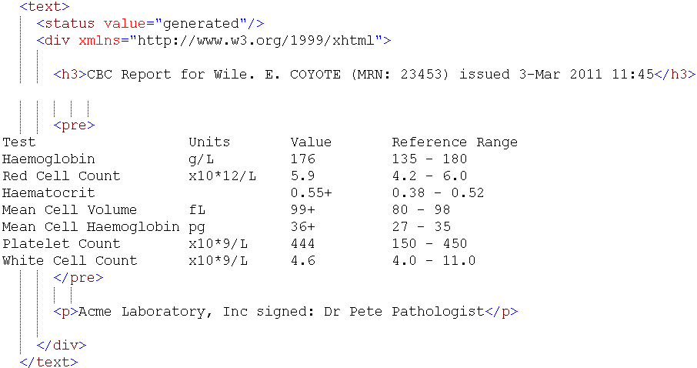
Narrative
Notes:
FHIR Narrative is an HTML rendering of the important clinical or business information in the resource for human viewing.
The inclusion of Narrative in almost all FHIR resources is a lesson we took from CDA. While our objective with FHIR is computable interoperability – sharing healthcare data in a way that lets computers understand it, it turns out that having human readability as a fallback is really useful. The reason is that not all systems that receive a FHIR instance are likely to support exactly the same data elements and extensions. Systems might get updated at different times. Data might propagate from one system to another to another to another or be stored and not looked at for a decade. At some point, a system is going to look at the data and not understand all of it. Being able to display all of the “important” information to a human user is therefore important.
Narrative isn’t mandatory, but if you’re storing data that might be shared at some point in the future, populating narrative is a really good idea.

Slide 16
Narrative Considerations
Should narrative be generated or human-entered?
What should be included and how should it be formatted?
When should you display narrative?
Notes:
There are several things to consider in your design with respect to narrative:
Will you generate the narrative from discrete data or allow a human to enter it. For something like a pathology report or perhaps a simple care plan, all you might have is narrated text
If you generate the narrative, what should be in it? What should appear first? How should it be formatted? What information do users want to see and what would be ‘noise’ to them?
If you receive narrative, when should the user see it? We have a flag that indicates whether the narrative was generated that can help with this.

Slide 17
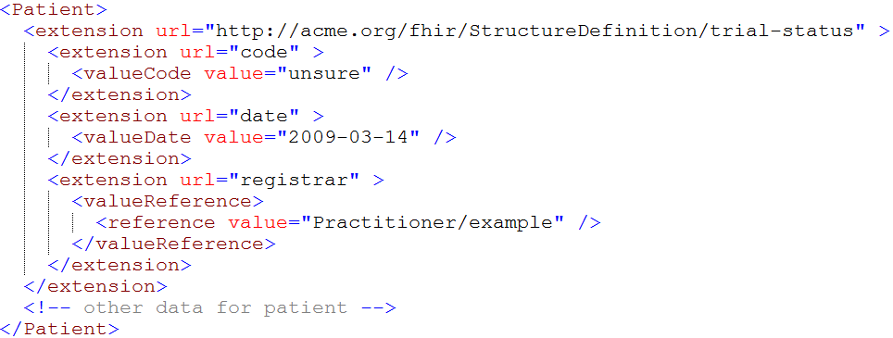
Extensions
Notes:
The next thing I want to talk to you about is extensions.
Extensions are an essential part of FHIR. In FHIR, we only include elements in the core specification if we believe most implementers throughout the world will support that element. However, every country, medical discipline and organization will have “extra” data. In the Netherlands, they have an address part for “boat across the street from”. In Saudi Arabia, they record birth date in both the Gregorian and the Hijri calendars. In Canada, when we capture your health card number, we also capture the version number on the card. All these elements are managed as extensions – so most implementers don’t have to worry about them.
Extensions keep the FHIR core specification ‘simple’. Without extensions, the Patient resource would have 300 or more data elements instead of 25.
In FHIR, extensions are built into the schema and are identified by a resolvable URL.

Slide 18
Extension Considerations
What do you do if you receive an unrecognized extension?
Should you store unrecognized extensions?
Should you display unrecognized extensions?
What should you expose as an extension?
Where should you register your extensions?
Notes:
There are several things to consider when it comes to extensions:
What do you do if you receive an extension you don’t recognize? (Hint – it’s bad practice to reject instances just because you don’t recognize an extension – extensions can be safely ignored.)
Should you store unrecognized extensions? If so, how could you do that?
What about displaying unrecognized extensions?
How do you decide whether to expose your own data as an extension?
If you create an extension, implementers need to be able to find it – where should you register it?

Slide 19
Modifier Extensions
Also a core part of FHIR
Needed because some extensions can’t be safely ignored
Can’t compute on an element containing an unrecognized modifier extension. However, can:
Reject instance
Remove element containing unrecognized modifier extension
Just display narrative
Retrieve definition & seek human review
When should you introduce them?
Notes:
Modifier extensions are a pain in the butt. A modifier extension is a special type of extension that can change the meaning of other information in the instance. For example, a flag allowing you to say that “patient did not have an appendectomy”. Modifier extensions have a different name because they’re not safe to ignore.
The first question to consider around modifier extensions is what to do if you see one you don’t recognize. Do you reject the instance? Strip out the containing element (for example, stripping off a Patient contact with a flag that says “do not contact”)? Display only the narrative? Have a human look at it and decide what to do?
The other thing to decide is when is it necessary to introduce them – keeping in mind that modifier extensions can interfere with interoperability.

Slide 20
Versions
33, v12 – 2012-12-04
/server.org/fhir/Patient/33/_history/12
33, v13 – 2012-12-05
/server.org/fhir/Patient/33/_history/13
33, v14 – 2012-12-08
/server.org/fhir/Patient/33/_history/14
33, v15 – 2012-12-09
/server.org/fhir/Patient/33/_history/15
/server.org/fhir/Patient/33
Notes:
Whenever you create or update a resource in FHIR, you’re implicitly creating a new “version” of that resource. However, systems are permitted to have a varying degree of version awareness – from full ability to return any historical version through to not having any clue if the record has changed, let alone who changed it or when.

Slide 21
Tags
Patient
MRN 22234
“Ewout Kramer”
30-11-1972
Amsterdam
Tag: system: http://example.org/fhir/Status
code: Test
Profile: http://hl7.org/fhir/StructureDefinition/us-core
Notes:
Tags give a mechanism of capturing additional information about a resource that live outside the content typically signed.

Slide 22
Tags
Allow data to be attached to a resource “outside” the resource
Doesn’t break signature when added/changed
3 types:
Security
Profile
General (workflow, etc.)
Require business agreement
Can’t search by tag if authors don’t include them
And populate the same way . . .
Notes:
Possibilities include security tags such as “this resource is extra sensitive” or “the information in this resource shouldn’t be shared with the patient”. They can also be used to capture what profile or profiles an instance complies with or to manage workflow, such as “Dr. Smith needs to see this report”. One of your architectural considerations will be what tags your system will leverage and how you’ll ensure that your communication partners either populate or understand those tags.

Slide 23
Reference libraries
Currently 5:
C#, Java, Pascal (Delphi), Javascript, Swift
More to come?
Handle parsing, serialization, validation, etc.
Also open source servers, basic clients
Notes:
HL7 provides reference libraries for many software languages that handle parsing, serialization and performing basic REST operations. Some of them also support validation and other functions. You’ll need to decide whether to leverage those open source libraries or build your own equivalents – and if leveraging, how you’ll manage as the libraries get updated from time to time to reflect enhancements, fixes and newer versions of FHIR.

Slide 24
Resource identity and location
What relationships will you need?
Where will referenced resources live?
How will you reference those resources?
Where’s the resource – bundled, contained, remote?
Notes:
FHIR resources exist in a cloud or network of interlinked instances. For example, an Observation might point to a Patient, a Practitioner and an Encounter. The Encounter might then point to the same Patient and a different Practitioner as well as a Condition which also points to the Patient… Those resources might be all packaged together in a message or document Bundle or they might be accessed separately, either on the same RESTful server or on separate ones.
FHIR provides a few options for referencing and containing resources. In REST, resources are referenced by URL – but those references can be generic or version-specific. In messages and documents, they can also be identified by GUIDs – which means there’s no mechanism to resolve them outside of the message or document.
In addition to remote and bundled resources, FHIR also allows “containing” resources. This is used when a resource has no independent identity and doesn’t have enough information to stand on its own. For example, if all you know about a prescription is that it was prescribed by “Dr. Petrov”, that’s not enough information to create an independent Practitioner resource.

Slide 25
Profiled FHIR
Notes:
When you look at FHIR resources, you’ll see that very few elements are mandatory. If you look at the Patient, resource, none of the root data elements are mandatory. That’s because there are valid use-cases in at least some systems where any one of those data elements are allowed to be missing. In fact, it’s completely legitimate for a system to not be able to store patient names. Maybe it’s an application for anonymized reporting. Or maybe it deals with cows or chickens.

Slide 26
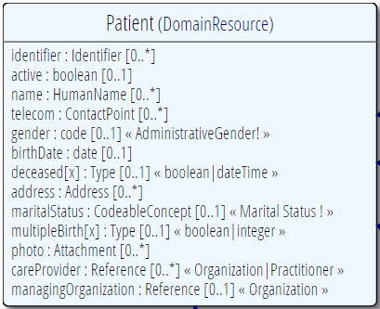
Profiling a resource
Demand that the identifier uses your national patient identifier
Limit names to just 1 (instead of 0..*)
Limit maritalStatus to another set of codes that extends the one from HL7 international
Add an extension to support “RaceCode”
Note: hardly any mandatory elements in the core spec!
Notes:
Profiles are FHIR’s mechanism for describing tighter rules for resources in the context of a particular implementation space. You can make elements mandatory. You can require that systems use particular code systems. You can tighten down what data types are allowed, for example saying that you can’t just have a deceased flag but must always specify a full “deceased date”. You can indicate what extensions are expected to be supported or define new extensions. You can also provide additional guidance and instructions about how implementers should map or interpret data.
Packages of these profiles can then be packaged together with related value sets and code systems, examples, capability statements and other conformance artifacts to form a FHIR Implementation Guide – a set of guidance for how to use FHIR to solve a particular set of problems in a specific environment.

Slide 27
Profile-less FHIR
You don’t need profiles to interoperate with FHIR
Resources are “discrete” enough that mechanism to populate most elements is clear
Approach
Populate/consume all elements you know, use HL7 or country-standard extensions for extras
Map to/from “recommended” terminologies as much as possible, populate CodeableConcept.text
Expose capabilities in CapabilityStatement resource
Notes:
Unlike CDA, you can get a reasonable degree of interoperability with FHIR without using Profiles at all. FHIR is much more concrete than CDA. Thus, different developers are much more likely to interpret the specification the same way for most elements. As a result, FHIR has pretty good “drive by interoperability” where you just hook up two systems and see what information can flow without specially configuring them. However, if you want to be sure that all information will flow, you’ll need profiles.

Slide 28
Profile Uses
Profiles are still quite useful
Define document and message boundaries
Define extensions
Set interoperability expectations in a particular context
National standards, types of care, business patterns
Clinical practice guidelines / detailed clinical models
Document system capabilities
Notes:
Profiles can be used for many things. You need them to define what content will be inside the Bundle for documents and messages. We use them to define new extensions. We use them when creating implementation guides, whether at the national, international or local level. You can use them to define clinical practice guidelines and best practices – for example “What should a blood pressure look like?” or “What should a pediatric oncology referral look like?”. Profiles are also used to describe what your system actually does.

Slide 29
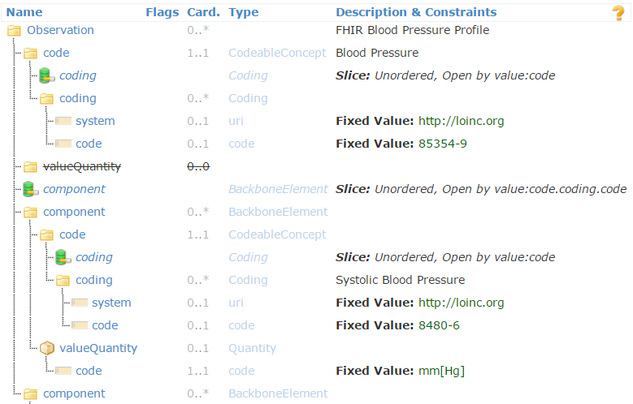
Profiled Observation (Blood Pressure)
Notes:
This is an example of a blood pressure profile. It sets constraints on what the Observation code is to provide a standard way of saying “this is a blood pressure”. Because blood pressure has two parts – systolic and diastolic, it prohibits specifying a value for the Observation overall, and instead defines two slices on Observation.component. Each slice sets the rules for a separate repetition. One repetition must have the code for “systolic blood pressure”. The other for “diastolic blood pressure”. Both require the units to be “millimeters of mercury”.

Slide 30
Profiles to guide behavior
Profiles can be used to dynamically configure system behavior
Load a profile to guide data entry
E.g. Oncology referral
Load a profile to guide data display
Notes:
One of the interesting things about profiles is that because they are computable and behave like any other resource, you can have a system that changes behavior after loading a profile – using the profile to guide what data gets entered or what data it already has that should be displayed to the user.

Slide 31
What now?
Notes:
10:00

Slide 32
Dealing with STU
FHIR is a “standard for trial use”
Anything can change – no compatibility promised
Changes driven by implementation feedback
Most changes expected in resources
Already significant implementation experience through reference implementations, connectathons
Some needed resources aren’t yet defined
Outbreak, Public Health Case, etc.
Some content will (hopefully) become normative in FHIR R4 (2018), but most won’t
What goes normative when will depend on degree of implementation
Notes:
FHIR is still a Standard for Trial Use. Some portions of it should be locked down at the end of this year, but most resources won’t be locked down until the next release at the earliest (in about 2 years) or even longer. The Trial Use phase allows us to gather feedback from implementers and make fixes if things aren’t right. As well, new content will continue to be added to the specification over time and that content will also need time for implementers to beat on it before we lock it down. As a result, if you’re implementing FHIR now, you need to allow for the possibility that some pieces of it might change in the future. It also means that *you* have an opportunity to change FHIR if you don’t think it’s doing something correctly.

Slide 33

Estimating
How much will implementing a FHIR solution cost?
Considerations
Reference implementations help
Learning curve is lower
Still a curve if unfamiliar with XML / JSON / REST
Faster to “drive by” interoperability
Can’t speed consensus
Tools to help with mapping to internal codes and structures, still takes time
Anecdotal is “faster” to “significantly faster” to implement
Notes:
When we set out to build FHIR, we wanted something that was faster and easier than what we’ve done before. Based on feedback from implementers, we’ve largely succeeded. FHIR has a lower learning curve, provides reference implementations so implementers can focus on their business rather than encoding rules. Anecdotally, the community indicates that solutions using FHIR get to production “faster” or “significantly faster” than those using previous standards.
However, it’s important to be realistic. FHIR doesn’t make mapping terminologies easier. FHIR doesn’t make doctors agree faster. FHIR won’t suddenly make the business processes of other systems align with your own. In other words, FHIR isn’t magic 😊
d be too busy to teach this course . . .

Slide 34
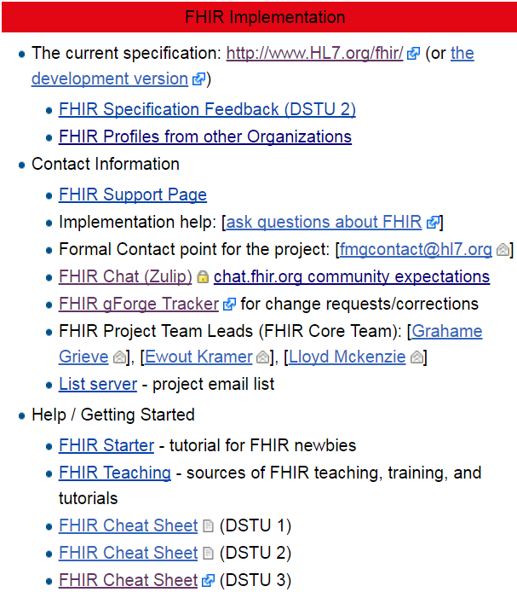
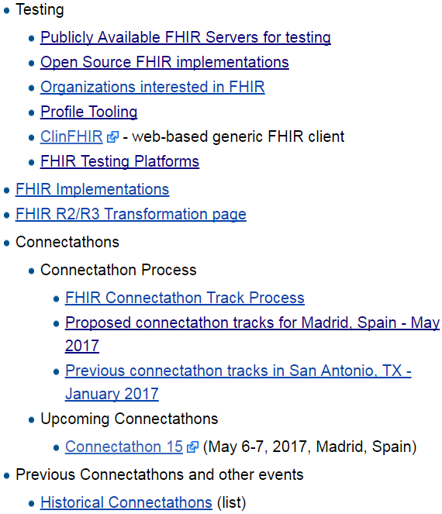
Resources wiki.hl7.org/?title=FHIR
Notes:
As Grahame said earlier, a key part of FHIR is the community. That community has put together a lot of resources to help new implementers. The best place to look for them is on the FHIR wiki. There you can find open source tools, tutorials, cheat sheets, public test servers, upcoming events, blogs and more.
To be really successful with FHIR, it’s important that you connect with the community. The best way to do that is through chat.fhir.org. If you have a question about something in the spec, ask. Someone probably has an answer and you’re much more likely to interoperate if you do what the rest of the community is doing. And once you’re up to speed a bit, don’t be afraid to answer questions either…
If you see something in the spec that doesn’t seem right or could be better, please use the “propose a change” link at the bottom of each page in the spec. In the last 6 years, we’ve received over 10,000 change requests. We consider and respond to every single one.

Slide 35

Next Steps for you
Read the spec: http://hl7.org/fhir
Join http://chat.fhir.org
Submit feedback (Propose a Change link)
Form your own local community
Come to FHIR Developer Days
Come to an HL7 WGM
Notes:
If you’re able to travel (which I know isn’t easy), coming to a Developer Days or HL7 WGM is a great way to learn the details of the spec, meet others who are also using FHIR and influence the evolution of the standard. If you can’t do that, then form your own local community and learn from each other.

Slide 36

Questions?
http://hl7.org/fhir lmckenzie@gevityinc.com
Notes:
I hope you’ve found that architectural overview helpful. As you dig deeper, if you run into questions, please reach out to the community. We’re there to help.

